Slide 1
Getting a cookie from the disclaimer page

Slide 2
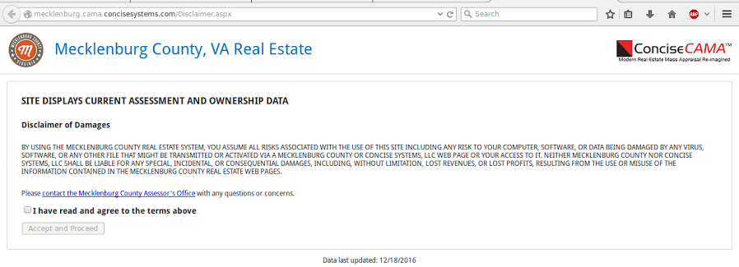
Disclaimer Page in Mecklenburg

Slide 3
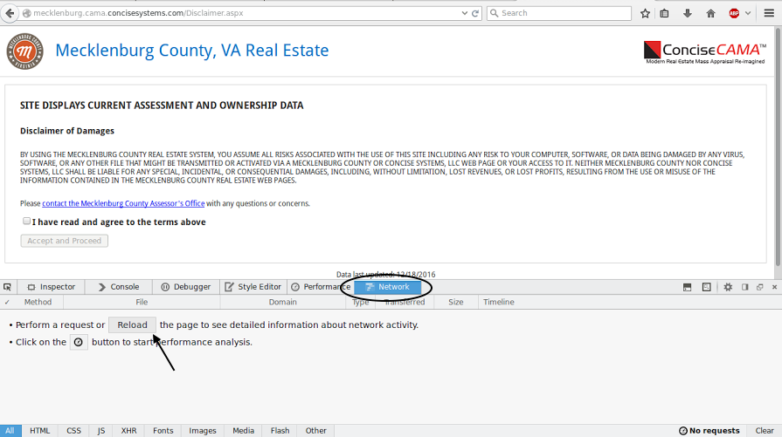
Inspecting element on

Slide 4
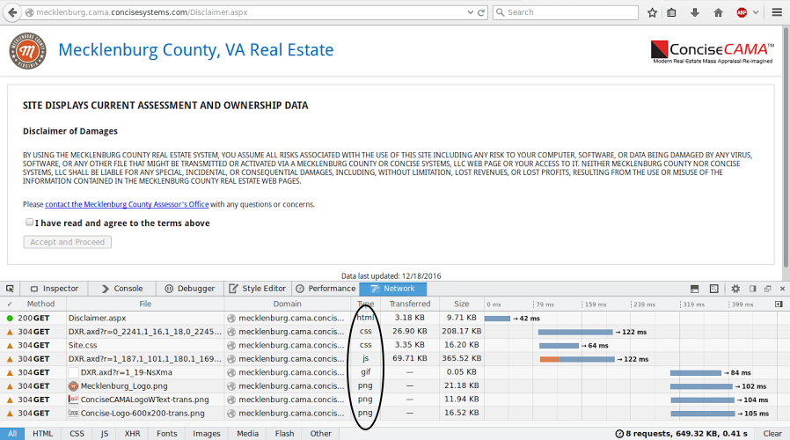
Network Page on inspect element

Slide 5
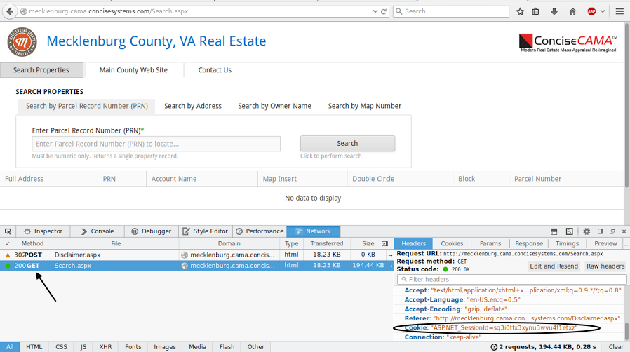
Getting cookie

Slide 6
Finding the information page from Pittsylvania

Slide 7
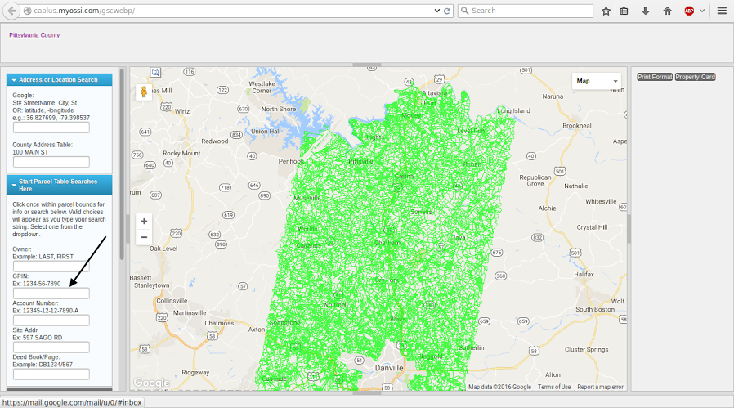
Pittsylvania Page

Slide 8
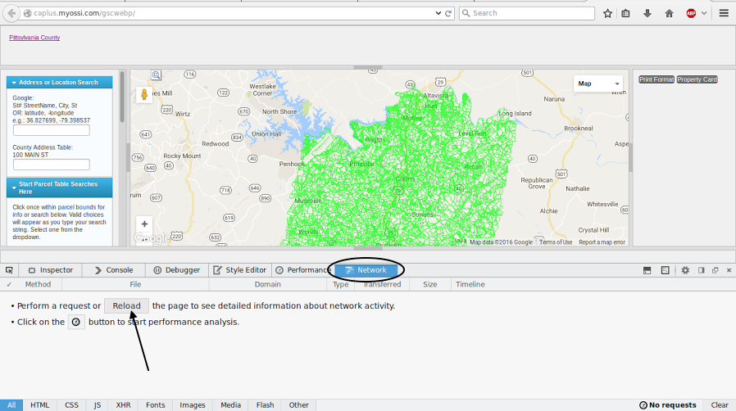
Inspect Element on Pittsylvania

Slide 9
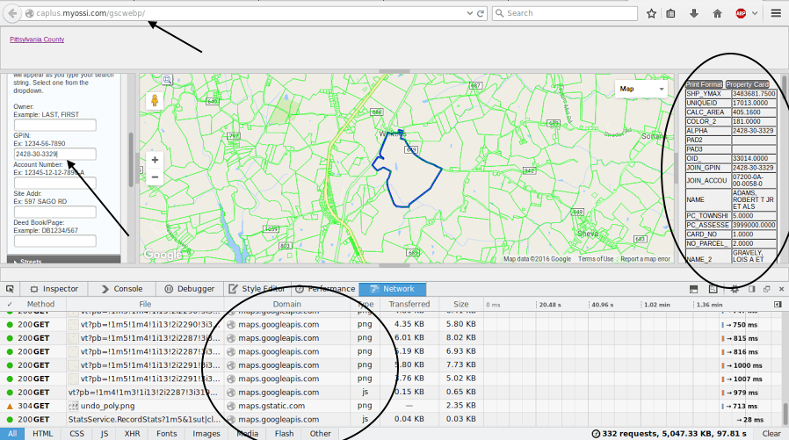
Searching for Parcel ID

Slide 10
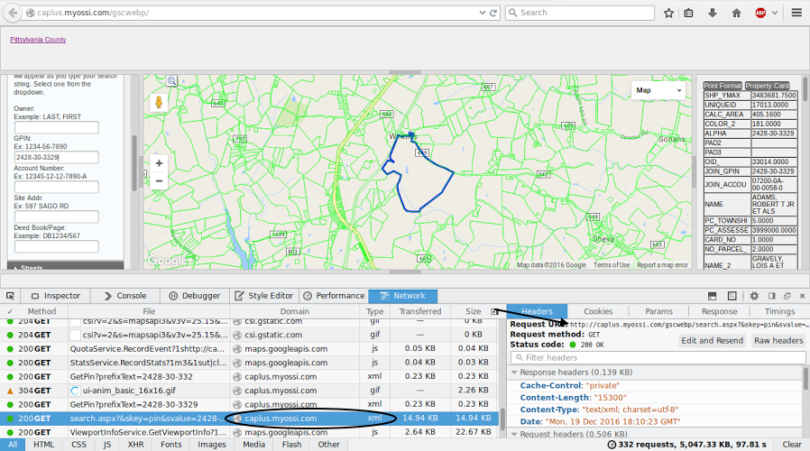
Finding correct server call

Slide 11
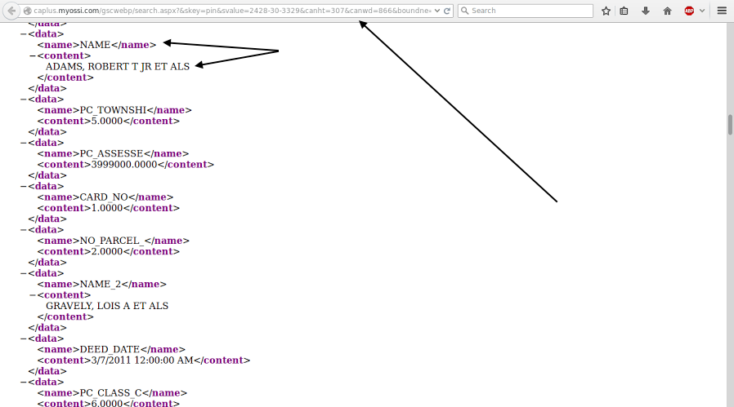
Pittsylvania Information Page

Slide 12
Finding the information page from Halifax

Slide 13
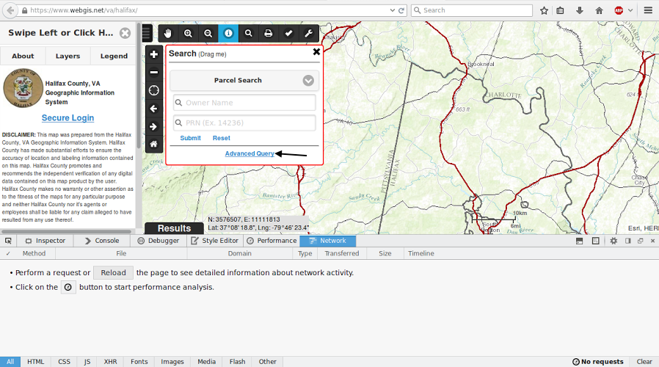
Halifax inspect element page

Slide 14
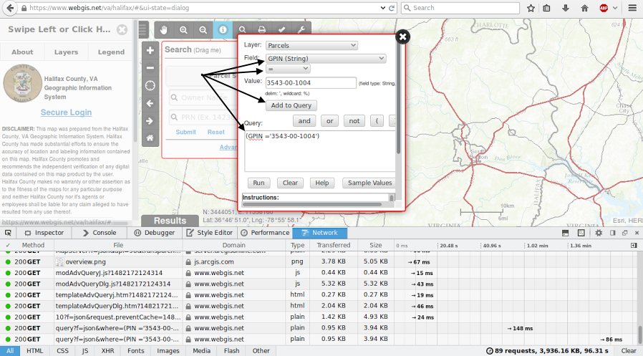

Slide 15
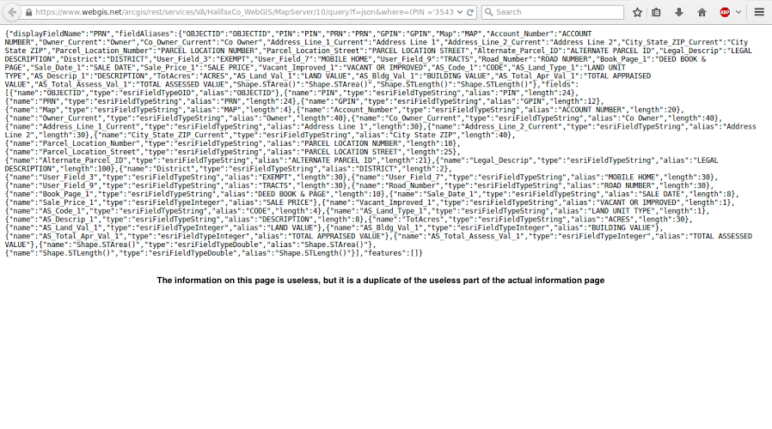
Halifax Useless Result page

Slide 16
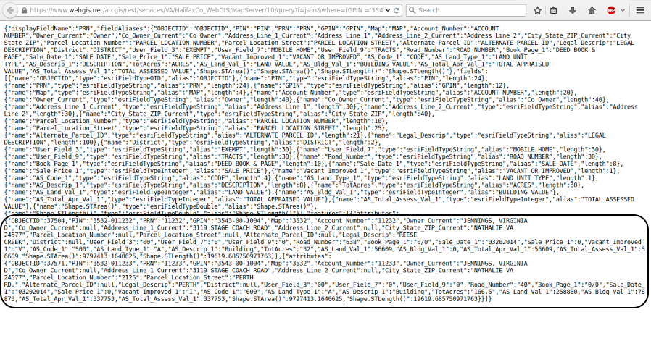
Halifax actual result page

